Slide 1
YOUTH DEVELOPMENT TROUGH DIGITAL SKILLS

Slide 2
PREAMBLE
In an era defined by rapid technological advancements, the future of any nation rests firmly on the shoulders of the youth. Nigeria, with over 60% of its population under the age of 25, equipping the young people with skills like coding, digital marketing, and data analysis transforms them from job seekers into job creators. In today’s digital economy, these skills break barriers and open global opportunities.

Slide 3
WHAT ARE DIGITAL SKILLS
Digital skills are the abilities you need to use computers, the internet, mobile phones, and other digital tools to find, create, and share information.
In 2026, they are as basic as reading and writing were 50 years ago.
Digital skills are not just for tech people, they are the survival skills for the 21st century. Whether you want to be a doctor, artist, trader, or CEO, digital skills decide how far you will go.

Slide 4
AIMS AND OBJECTIVE
Economic Empowerment
Digital skills reduce youth unemployment by training youths for-high demand tech jobs.
Social Development
Encourages civic participation through digital advocacy, content creation, and online community building
Future Readiness
Prepare youth for industry 4.0 jobs in AI, cybersecurity, cloud computing, and data science.

Slide 5
ADVANTAGES
Digital skills reduces dependence on government jobs or family support.
Digital work removes physical barriers, helping young women earn independently.
Tech-savvy youths builds apps which helps solve local problems.
It provides equal opportunities for youth in rural areas and urban areas.
Digital skills pay 3x-5x more than many traditional entry-level jobs in Nigeria.
It creates a sense of achievement for youth.

Slide 6
DIGITAL SKILLS TO LEARN
Digital Marketing : Helping businesses get customers online
UI/UX Design: Building websites with WordPress, Wix, Webflow.
Web Development: Building sites and apps with React.
Cybersecurity: Protecting companies from hackers.
AI Prompt Engineering: Building Workflows with ChatGPT.
Graphic Design: Make flyers, logos, social media posts.

Slide 7
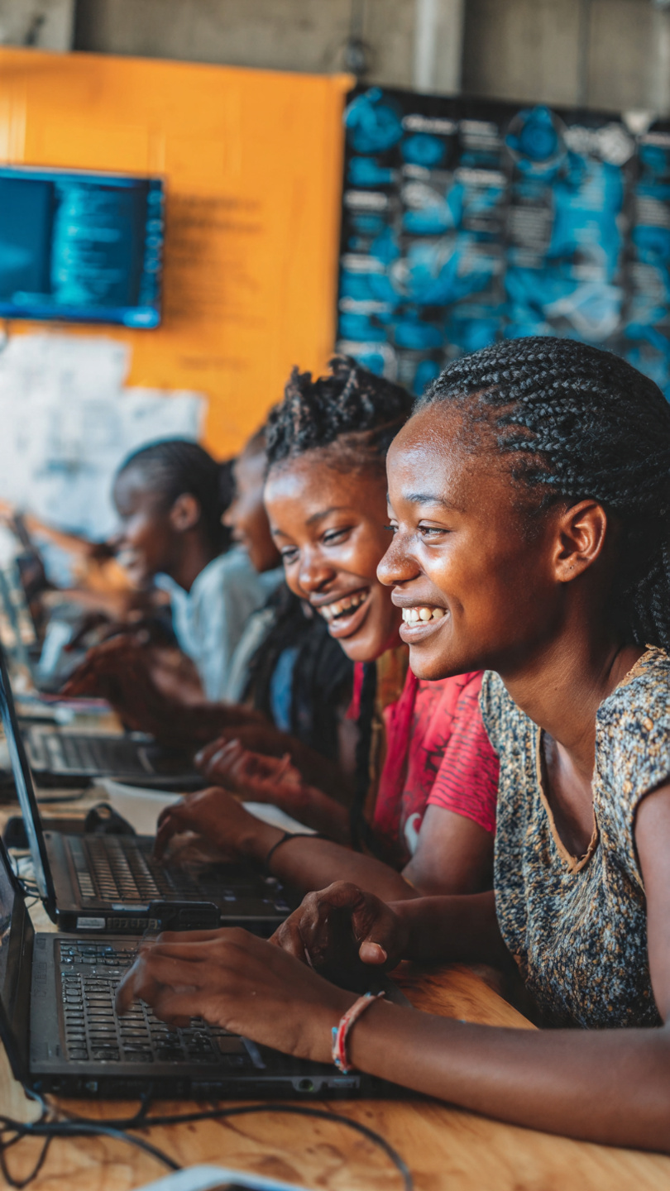
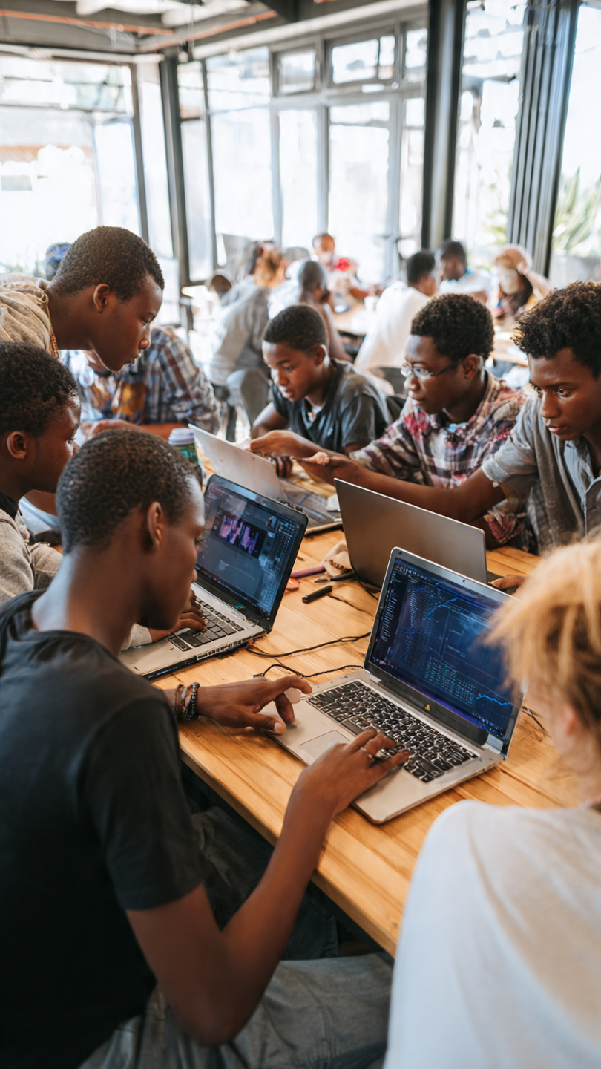
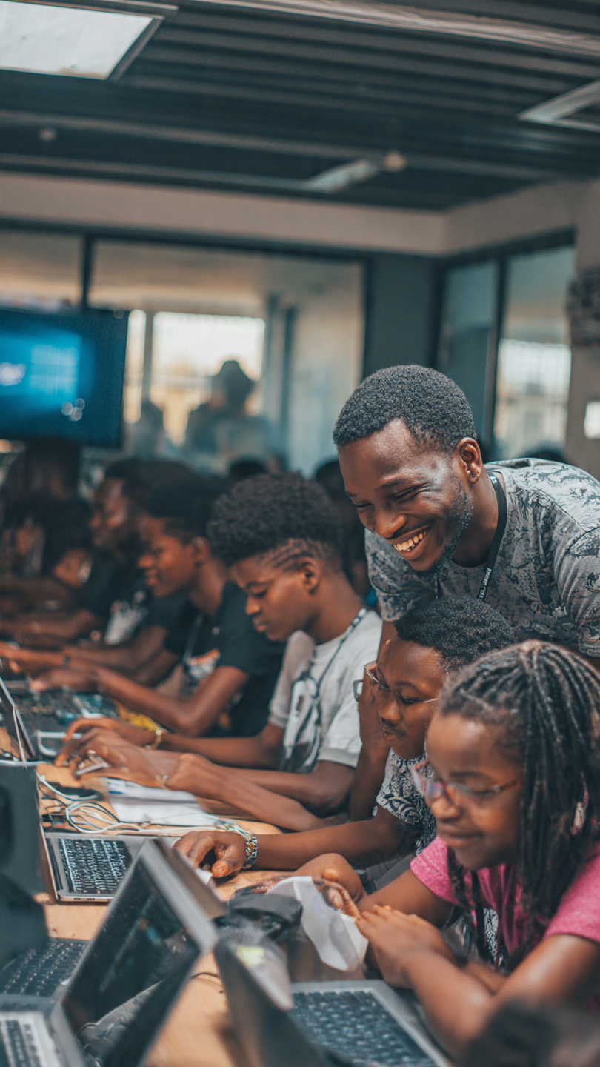
IMAGES OF YOUTH LEARNING DIGITAL SKILLS

Slide 8
SUMMARY
In the 21st century, digital skills are the fastest route to youth development. When we teach one youth to code, design, or market online, we don’t just change their life, we also lift families, communities, and the nation.
The future belongs to the digitally skilled. Empowering youth with these skills today secures Nigeria’s place in tomorrow’s economy

Slide 9
THANK YOU

